Slide 1
TFTP: Trivial File Transfer Protocol
For ECEN-602
Source: erdos.csie.ncnu.edu.tw/~ccyang/TCPIP/Slides/Chap-21.ppt

Slide 2
21-2 TFTP
There are occasions when we need to simply copy a file without the need for all of the features of the FTP protocol. For example, when a diskless workstation or a router is booted, we need to download the bootstrap and configuration files. Here we do not need all of the sophistication provided in FTP. We just need a protocol that quickly copies the files.
TCP/IP Protocol Suite

Slide 3
Topics Discussed in the Section
Connection
Messages
Data Transfer
UDP Ports
TFTP Example
TFTP Options
Security
Applications
TCP/IP Protocol Suite

Slide 4
3 Main Phases of TFTP communication
Initial Connection: The TFTP client establishes the connection by sending an initial request to the server. The server responds back to the client and the connection is effectively opened
Data Transfer: Once the connection is established, the client and server exchange TFTP messages. One device sends data and the other sends acknowledgments
Connection Termination: When the last TFTP message containing data has been sent and acknowledged, the connection is terminated
TCP/IP Protocol Suite

Slide 5

Note
TFTP uses the services of UDP on the well-known port 69.
TCP/IP Protocol Suite

Slide 6
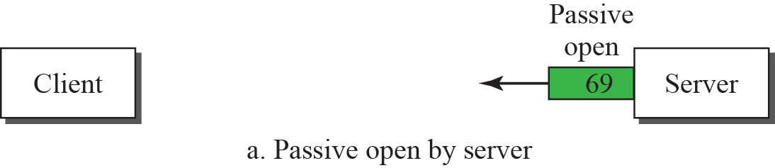
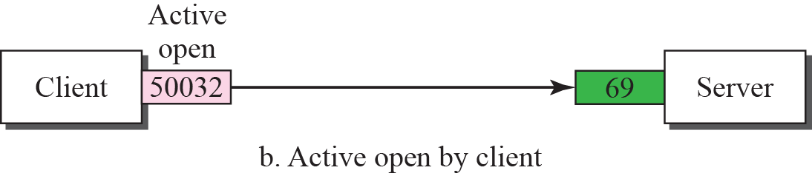
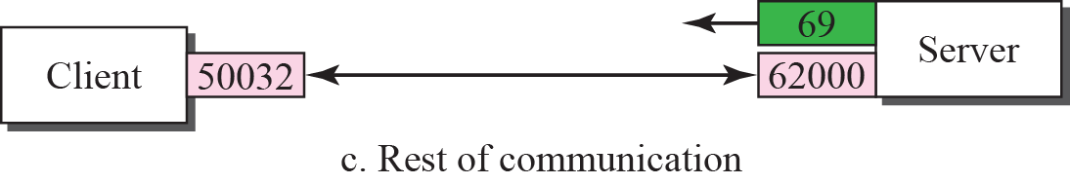
Figure 21.18 UDP port numbers used by TFTP
TCP/IP Protocol Suite

Slide 7
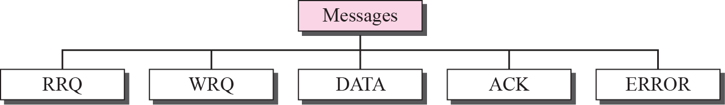
Figure 21.10 Message categories
TCP/IP Protocol Suite

Slide 8
Figure 21.11 RRQ format
TCP/IP Protocol Suite

Slide 9
Figure 21.12 WRQ format
TCP/IP Protocol Suite

Slide 10
Figure 21.13 Data Format
TCP/IP Protocol Suite

Slide 11
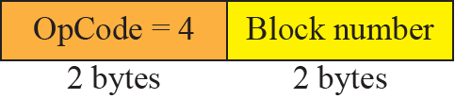
Figure 21.14 ACK format
TCP/IP Protocol Suite

Slide 12
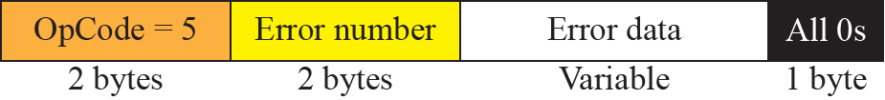
Figure 21.15 ERROR format
TCP/IP Protocol Suite

Slide 13
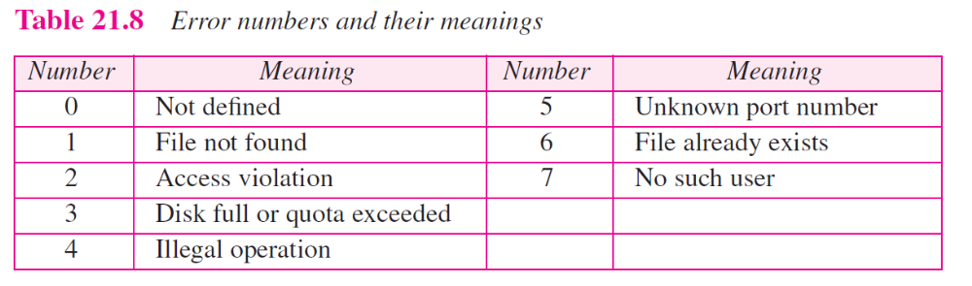
TCP/IP Protocol Suite

Slide 14
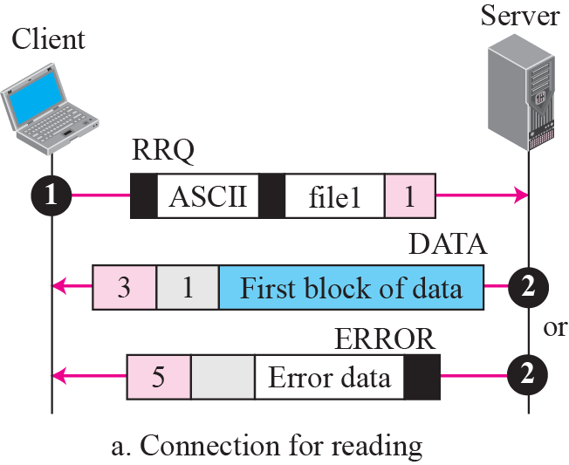
Figure 21.16 Connection establishment
TCP/IP Protocol Suite

Slide 15
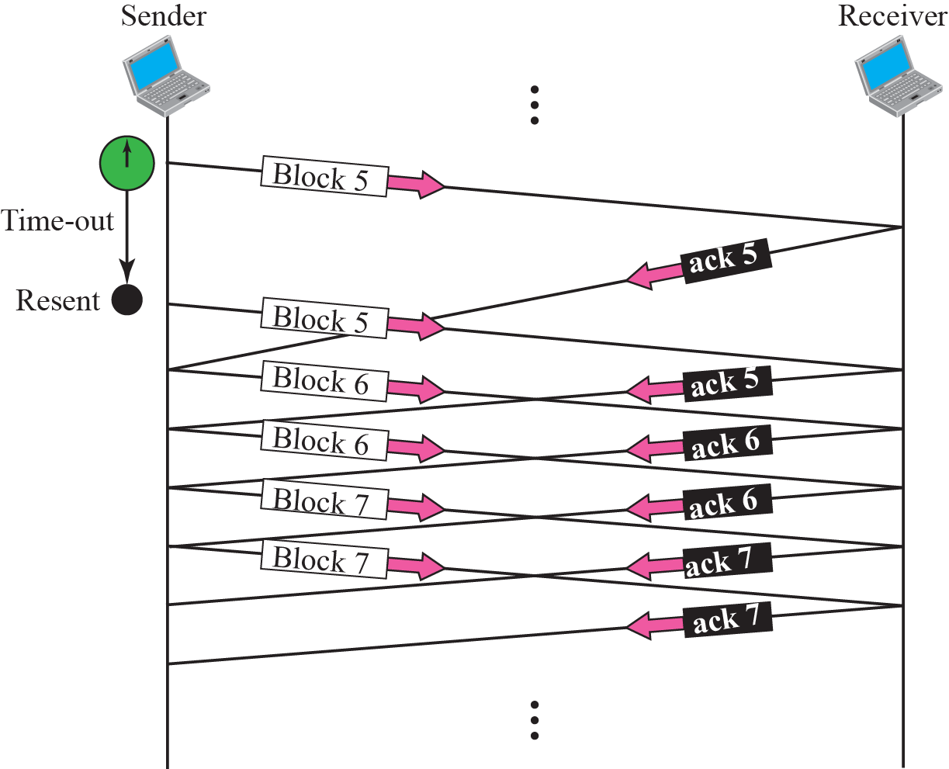
Figure 21.17 Server’s apprentice bug
TCP/IP Protocol Suite

Slide 16
TFTP Server Design
Identify Server Components:
  Data structure to store client information
  Messages
Handling client connections:
  Use select() to handle concurrent connections
  Sanity check
  Send appropriate messages for errors
Data Transfer:
  Identify the client to which to send chunks of data
  Data is fixed size (512 bytes)
  Use lseek() to send data from an offset
  Max size of file?
TCP/IP Protocol Suite

Slide 17
TFTP Server Components
Data structure to store following information
  Client Address information
  Socket created for each client
  The currently open file for the client
  Pointer to next client (linked list)
Messages like Data and client requests can be different structures:
  Opcode
  Block No/Error Coe
TCP/IP Protocol Suite

Slide 18
TFTP Handling client connections
Server client handling steps
  Create a main socket for listening connections
  Bind to address
  Use select() to toggle between connections
TCP/IP Protocol Suite

Slide 19
TFTP Handling client connections using select()
If new connection:
  Create a ephemeral socket for new connections using random port
  Sanity check like proper file name/access to file
  Add client to list
  Send response with data
TCP/IP Protocol Suite

Slide 20
TFTP Handling client connections using select()
If old connection:
  Identify the client in list
  Check which block to send using ack message response
  Use lseek() to find appropriate block to send
  Send data using sendto()
  Check if ack received for last data block in file to close connection
TCP/IP Protocol Suite

Slide 21
TFTP Data transfer
lseek():
  Off_t lseek(int fd, off_t offset, int whence)
  lseek() respositions the offset of the open file associated with fd
  Using argument offset and directive whence
  Offset = block no * 512
  Whence = SEEK_SET
TCP/IP Protocol Suite

Slide 22
TCP/IP Protocol Suite

